Slide 1

CASE STUDY 2
Swami Vivekananda Yoga Anusandhana Samsthana, Bengaluru
SVYASA Yoga University
Arogyadhama Presentation On
Chronic Low Back Pain (CLBP)
Section E-BHAVANA
Life Science
Presented By: Mridhul TP, Student – M.Sc. (Yoga) Distance
Registration No. 40119159

Slide 2
1. Introduction to the Section:
1.1 Section Name: Section-E - BHAVANA (Back Pain and Neck Pain )
1.2 Doctor In-charge: Dr. Padmini Tekur
1.3 Therapist: Mr Jalandhar
1.4 Consultant: Dr. R. Nagaratna
2. Introduction to the Ailment:
2.1 Definition:
Low back pain defined as pain or stiffness and discomfort, localized below the costal margin and above the inferior gluteal folds, with or without leg pain, and is defined as chronic when it persists for 12 weeks or more. It (Low back pain) is a symptom not a disease, and can result from several different known or unknown abnormalities or diseases.
Non-specific back pain is a pain is not due to any specific or underlying diseases that can be found. The pain is not related to any bone injury in the spine.it likely involve the muscles.

Slide 3
2.2 Causes:
Most low back pain is the result of an injury, such as muscle sprains or strains due to sudden movements or poor body mechanics while lifting heavy objects.
There are theories about psychological and emotional factors causes some kind of physical changes that resulting back pain. The stress related back pain is a “psychosomatic” or “psycho-physiological” one.
Low back pain can also be the result of certain diseases, such as:
Cancer of the spinal cord
A ruptured or herniated disc
Sciatica
Arthritis
Kidney infections
Infections of the spine

Slide 4
Back pain is not a disease but a constellation of symptoms which origins remain in most cases unknown even though risks factors have been identified.
2.3 Signs and Symptoms:
The most noticeable symptom of pain in the back and neck is the pain from the spine to the arms and numbness in the fingers or, if pain in the back is present, pain may radiate from the lower back to the buttocks or legs and numbness in the lower limbs and toes. General signs involve weakening of the legs or hands, failure to grasp adequately and to move or to look around may even be signs of something more risk.
2.4 General line of treatment:
muscle relaxants
nonsteroidal anti-inflammatory drugs (NSAIDs)
narcotic drugs such as codeine for pain relief
steroids to reduce inflammation
corticosteroid injections
Antidepressants

Slide 5
Paracetamol
Doctor may also prescribe physical therapy, including:
massage
stretching
strengthening exercises
back and spinal manipulation
3. Case Writing:
1.1 Biographic Data:
Name: Ashwin
Address: Bangalore
Age: 28
Sex: Male
Marital Status: Unmarried
Education Qualification: B. tech
Occupation: Software engineer

Slide 6
Date of Admission: 14-02-2021
Date of Discharge: Discharge (As on 28-Feb-2021)
3.2 Chief Complaint:
Low back pain since 1 year.
3.3 History of Present Illness:
The patient was apparently normal before 1 year. after that, He has been experiencing recurring Low Back pain.
Now, pain radiate to the both Legs.
Pain Intensify on prolonged sitting, standing, walking , lifting of heavy objects, traveling etc..
He has Lack of concentration for these days.

Slide 7
3.4 Past History:
(1) Childhood disease: Nothing Significant
(2) Allergies: Nothing Significant
(3) Accidents and Injuries: Nothing Significant
(4) Hospitalization: No
(5) Medication: Nothing Significant
3.5 Family History of Illness:
(1) Paternal: Diabetics
(2) Maternal: Obese
(3) Sibling: No
3.6 Personal History:
(1) Addictions if any: No
(2) Nutrition Pattern:
a. Vegetarian/Non-Vegetarian: Non - Vegetarian

Slide 8
b. Typical daily food intake: 3 times a day. However, mostly skip break-fast
c. Typical daily fluid intake: 2 litres.
d. Weight loss/gain ? Amount: Weight gain 3 kg
e. Appetite: Reduced appetite
(3) Elimination Pattern:
a. Bowel: Constipation, Once in a day but
b. Bladder: 3-4 times / day
c. Sweat: Rarely
(4) Menstrual History: Not Applicable
(5) Activity-Exercise Pattern:
a. Duration/Type of exercise: Never did before
b. Spare time activity: Internet Browsing.
(6) Sleep Rest Pattern: Sound sleep, 7 to 8 hours a day.
3.7 Stress History: Work related Stress.

Slide 9
3.8 Physical Examination:
1. Vital Signs
a. Pulse: 79 beats/minute
b. Respirator Rate: 22 cycles/minute
c. Blood Pressure: 129/77 mmHg
2. Anthropometric Measurements
a. Height: 167 centimeters
b. Weight: 79.5 kg.
c. Body Mass Index (BMI) kg/m²: 28.5
3.9 Investigations and findings:
Nothing significant in MRI scan.
A unified single cause couldn't be identified. Hence, we assumes that work related stress , lack of exercises , over wight , food habit, sedentary life style are resulting the Chronic Low back pain for the patient.
4. Final Diagnosis: Non Specific Chronic Low back pain.

Slide 10
3.8 Physical Examination:
1. Vital Signs
a. Pulse: 79 beats/minute
b. Respirator Rate: 22 cycles/minute
c. Blood Pressure: 129/77 mmHg
2. Anthropometric Measurements
a. Height: 167 centimeters
b. Weight: 79.5 kg.
c. Body Mass Index (BMI) kg/m²: 28.5
3.9 Investigations and findings:
Nothing significant in MRI scan.
A unified single cause couldn't be identified. Hence, we assumes that work related stress , lack of exercises , over wight , food habit, sedentary life style are resulting the Chronic Low back pain for the patient.
4. Final Diagnosis: Non Specific Chronic Low back pain.

Slide 11
5.Treatment/Management:
Yoga:
Annamaya Level / Physical : Special technique for back ,nee and neck pain
Pranamaya Level /Breathing : Pranamaya and Breathing practices to improve
lung function.
Pranamaya Level /Breathing : Pranamaya and Breathing practices to improve lung function.
Manonmaya Level / Meditation : Om, cyclic Meditation, MSRT , PET
Vijnanamaya Level / Counselling : Read and follow bhakti yoga ,karma yoga and jnana Yoga and rajayoga for life style modification.
Anandamaya Level/ Self : Find enjoyment in all and to realize the happiness is within
Diet: Yogic Diet:
Ahara : Satvik diet
Food to avoid : oily , Spicy , junks , processed and packed food.
Food to consume :
Vegetable : Rots and tubers , Leafy vegetables.

Slide 12
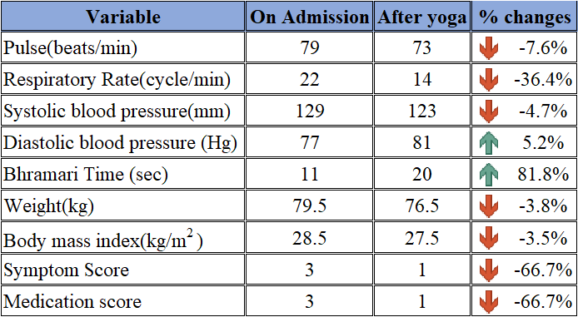
Greens : Spinach , Fenugreek.
Pulses : Green Gram, Bengal Grams.
Fruits : Papaya, Water melon, water.
Grains : Whole Grains Multi grains.
6. Parameters
All the Details of variables are given below.
Note: Percentage change formula: ((AY-OA) / OA)*100

Slide 13
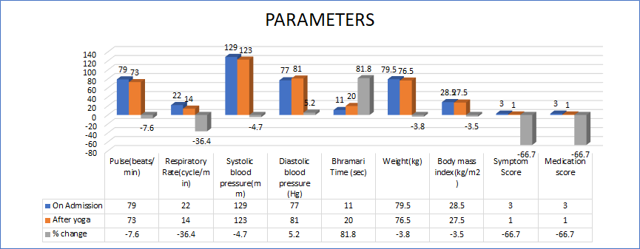
Graph of Parameters

Slide 14
Conclusion:
participant has chronic nonspecific back pain. Yoga techniques and yogic diet have been advised to the participant. He has certainly caught the concept of yoga way of life and importance of adapting in his life that has improved his health a lot.
7.1 Participant’s Feedback: When the participant came to Prasanti kutiram, anxious and unhappy about his condition, he had a notion that he would never recover from the pain in his back and legs. After entering the pain portion of his back and neck through the IAYT process, he said that the yogic activities helped him not only to relieve the pain in his back and legs, but also to restore his confidence and get back on track.
7.2 Practices found beneficial by participant :
The participant is completely satisfied with IAYT MODULE.

Slide 15
Thank You

